Slide 1
My Career Shines

Slide 2
My Career Shines
Open Internet Explorer
On the Symbaloo page, click on the mycareershines.org hyperlink:

Slide 3
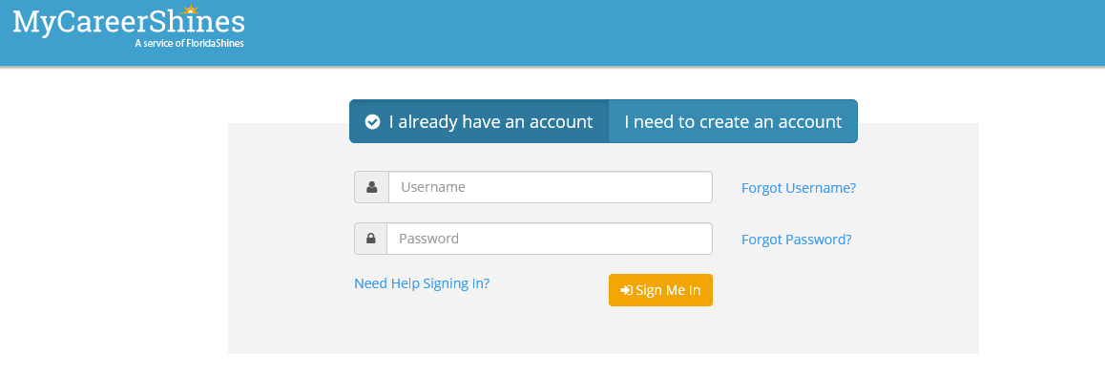

Slide 4
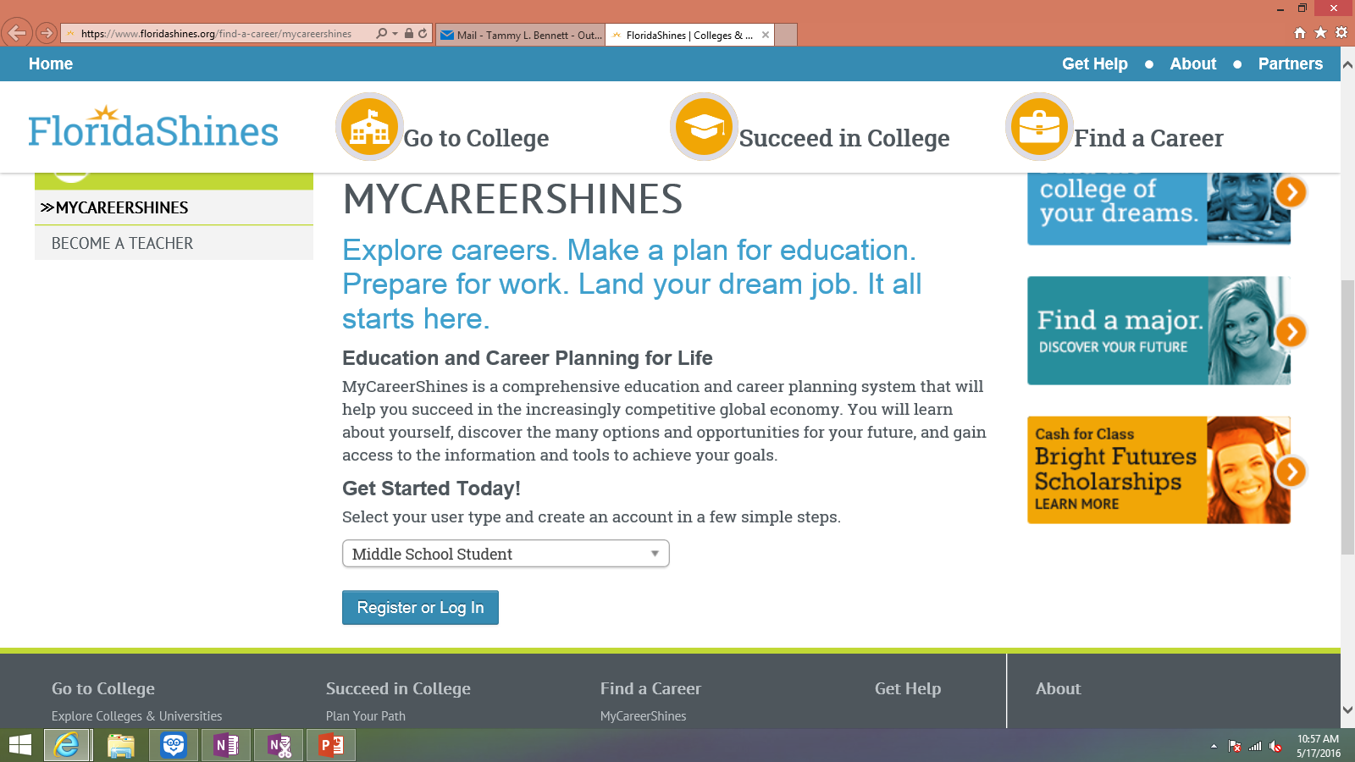

Slide 5
Step 1
Select Grade Level
Select High School Graduation Year
Select St. Johns County
Sebastian Middle School

Slide 6
Step 2
Enter your First & Last Name
Zip: 32084
Birthdate
Gender
Email: Neither

Slide 7
Step 3
Username: snumber
Password: first & last initial mmddyear (Example: tb06301999)
Select a secret question, answer the secret question

Slide 8
Step 4
Answer/prefer not to answer demographic questions
Accept the terms and conditions
Sign Me Up!

Slide 9
Take An Assessment
Once you have taken an assessment, you may Explore Occupations & mark your favorites.

Slide 10
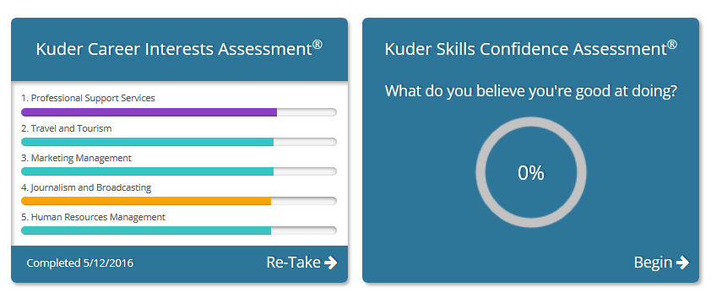
Two Self-assessments

Slide 11
