Slide 2
Mrs. Gabaldon, Principal Mrs. Hensley, Asst. Principal Mr. Hayes, Dean Mr. Hodges, Literacy Coach Ms. Fortune, Guidance Counselor Mr. Tagliarini, Guidance Counselor
Notes:
King

Slide 3
Sebastian Middle School’s vision is to cultivate high achieving, college and career ready students who excel in a complex and changing world.
Notes:
King

Slide 4
Our Core Values
Personalization
Growth Mindset
Project Based Learning
STEAM & Blended Learning
Inquiry Based Learning
Notes:
King

Slide 5
Implementation
Personalization and Growth Mindset
Single School Culture
Inquiry Hour Wednesdays – A/B schedule - project based learning
Eagle Points with PBIS Rewards - Eagles Nest & Incentives
Parent Involvement - PTO, SAC, Communication Cornerstone
Notes:
King

Slide 6
Growth Mindset
Thursday November 7th

Slide 7
Single School Culture

Slide 8
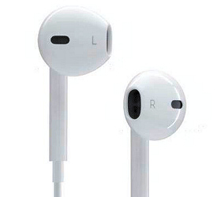
Show Respect
Own Your Actions
Accept Differences
Realize Your Potential
Do You have your planner? | Is your sweatshirt hood down?
Are your earbuds and phone away? | Do you need any help before I see you tomorrow?

Slide 9
Positive Behavior Incentives
Students are able to earn points in class and monitor their points through the app
Classroom Incentives
Flexible seating
Homework pass
Corner store
School Wide Incentives
Dances
Eagle Store
Eagle’s Nest

Slide 10
What can we help you with?
School adjustment concerns
Coping, problem-solving, self-regulation concerns
Organization/ study and test-taking skills
Peer relationships, conflicts
Red Ribbon week - Substance abuse prevention
Refer families to school -community support services
Guidance
How do we help you?
Class lessons
Small groups
Individual sessions
If you have an emergency situation that involves danger to self or to another person immediately contact a teacher/ counselor.

Slide 11
Implementing Our Values
Professional Learning Community (PLC)
Interdisciplinary Unit Plans
Project Based Learning
School Wide Novel Studies
Notes:
King

Slide 12
Inquiry Hour-Semester 1
CHANGES
Grade 6
CHOICES
Grade 7
Challenges
Grade 8

Slide 13
Inquiry Hour-Semester 1
Will explore essential questions through Project-Based Learning.
Remediation will occur during this time.
Students will spend 8 weeks with their assigned Inquiry Hour teacher.
Grade 6: Changes
How can we make water potable and accessible for all?
Grade 7: Choices
How do technological innovations affect society?
Grade 8: Challenges
How can we stop the spread of diseases?

Slide 14
Voice and Choice

Slide 15
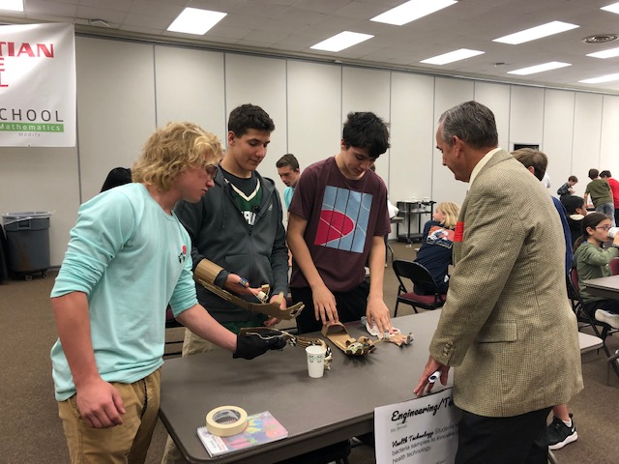
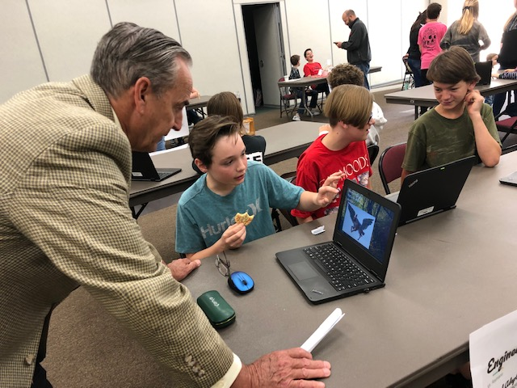
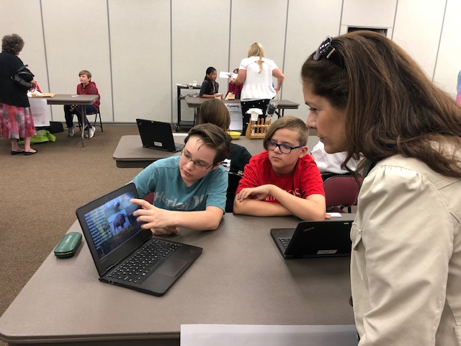
Exhibition
November 20th
8:00am to 11:00am

Slide 17
STEAM Elective Class
ICT with Tech Certifications
STEAM Project Based Learning in Core Subjects
Community Projects and Special Events
Robotics Club
Science Fair, History Fair, Field Trips
Media Center Maker Space
Notes:
Barbour

Slide 18
Blended Learning
Notes:
Barbour

Slide 19
Media Center - SSYRA

Slide 20
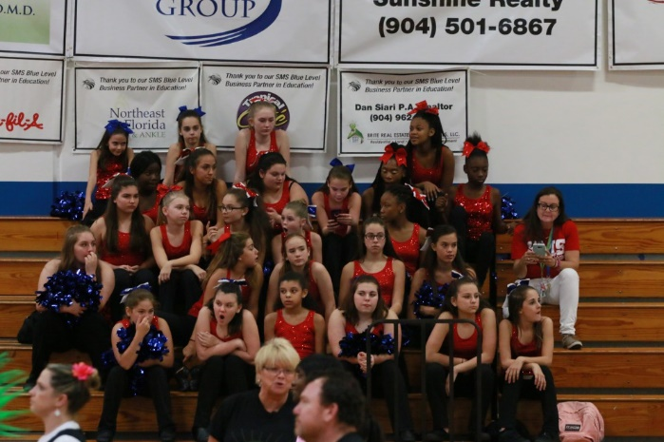
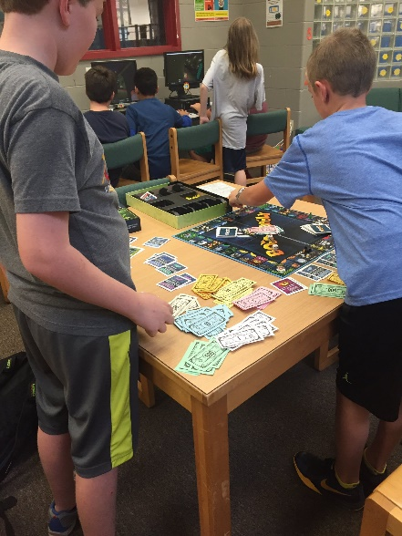
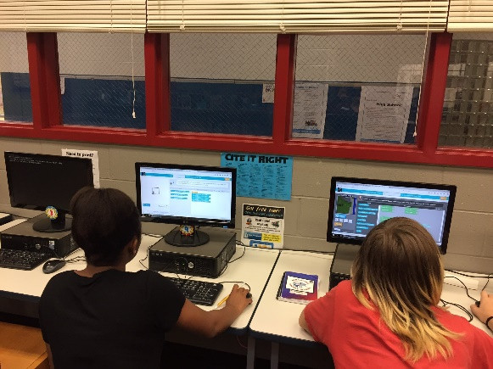
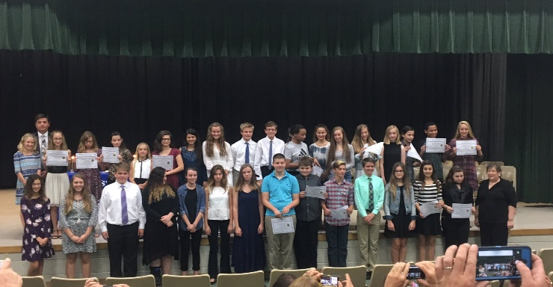
Middle School Activities
Orchestra
Drama
National Junior Honor Society
Student Council
SWAT
Builders Club
Art Club
Robotics
Cross Country
Yearbook
Volleyball
Dance Team
Basketball
Tutoring
SJMSAA

Slide 21
Building a Safe Learning Community
Character Counts
Anti-Bullying Programs
Alcohol & Drug Education
Guest Speakers
Monthly Safety Drills
Surveillance Cameras
YMCA
Notes:
Gabaldon

Slide 22
School Messenger
Communication Cornerstone
Schoology.com
SAC - School Advisory Committee
PTO - Parent Teacher Organization
@SMSEagles16
Notes:
King – pass to Gabaldon

Slide 23
Who do I ask for assistance?
Specific class questions - Classroom Teacher
General academic questions or emotional and social concerns - Guidance Counselor
Ms. Fortune (8th, 7th M-Z)
Mr. Tagliarini (6th, 7th A-L)
Behavioral concerns - Dean Hayes
Media Center- Mrs. Barnard
Reading Plus / Literacy – Mr. Hodges
Home Access Center - Ms. Willey
Notes:
King

Slide 24
What is Title I?
Title I is a federal program designed to offer supplemental services and supplies at schools with a high rate of poverty to ensure that every child has access to a quality education.
SMS is one of 12 Title I schools in St. Johns County (50% or more of students qualify for free/reduced lunch).
At SMS, Title I funding supports student achievement through:
Differentiated teaching methods and materials
Additional parent outreach and support via a Parent Liaison staff position

Slide 25
PTO
2019-20 PTO Board Members
Jen Stevenson- President
Jo Ellen Parkey- Vice President
Stefanie McMaugh – Secretary
Jennifer Farrow – Treasurer
Jenny Persson – Asst. Treasurer
Jessica Hoffman – Eagle Store
Deidre Kenny/Jackie Baird - Hospitality
Join PTO simply by giving us your email address tonight, or email us directly at PTOSebastian@gmail.com
PTO meetings
Volunteer opportunities: Eagle Store
Shop through AmazonSmile!
Consider becoming a Business Partner
Buy SMS Spiritwear – more items to come before the holidays!

Slide 26
Business partners Thanks to our SMS Business Partners who have joined so far this year!
Red Partner
Gordon Dental
Jet Consulting Inc.
Blue Partner
T6 Studios LLC
The J. Phillip and Davise Mahoney Family
Florida Landscape and Nursery Inc.
Purple Olive
BEHST Builders
GZ Handyman Services LLC
A-Ford-Able Automotive Services, Inc
Jersey Mike’s (catering dinner for teachers Thursday night)
Chicken Salad Chick (catering dinner for teachers on Tuesday)
Eagles Partner
Realtor, Sunshine Realty, Dan Lang
Principal
Diane's Natural Market
Bailey Health Solutions
Abare, Kresge & Associates
Coastal Foot and Ankle Wellness Center
Marble Slab Creamery
Pinnacle
The Halbrook Family Foundation

Slide 27
Opportunities this evening
Book fair in the Media Center
PTO in the Media Center
SJCPLS in the Media Center
Mr. Hodges in the media center to answer any questions on literacy or inquiry hour
Visit classrooms to meet the teachers

Slide 28
Thank you

